Slide 1
WHO’s work on comprehensive sexuality education
October 2019
Venkatraman Chandra-Mouli Marina Plesons
chandramouliv@who.int plesonsm@who.int

Slide 2
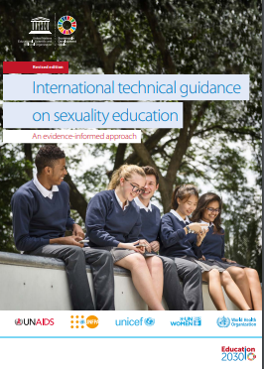
1. Contributing to the development of the Revised International Technical Guidance on Sexuality Education
Includes the latest evidence & lessons learned from implementing CSE programmes across diverse education settings.
Reflects a deeper understanding of the relevance of CSE to young people’s healthy development & overall well-being.
Enhances and expands the key concepts, topics & learning objectives.
Presents sexuality with a positive approach.
Reaffirms the position of CSE within a framework of human rights & gender equality.

Slide 3
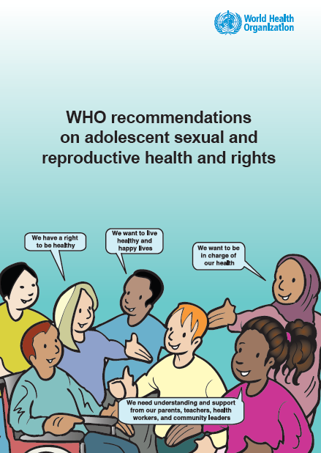
2. Contributing to the dissemination/application of the
Revised International Technical Guidance on Sexuality Education

Slide 4
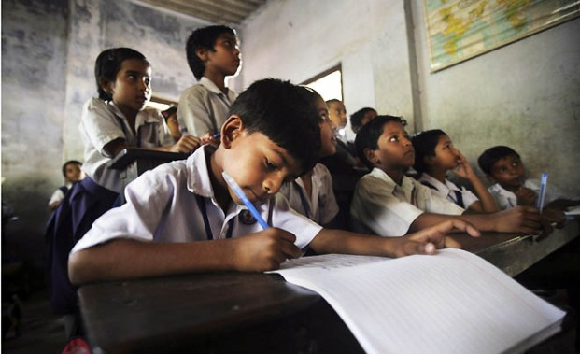
Sexuality education: The reality on the ground
3. Supporting the application of the Revised International Technical Guidance on Sexuality Education
Weak content:
Inadequate information about contraception
Key aspects of sex, reproduction & sexual health were missing
Weak delivery:
Some teachers lacked the needed skills
Most did not want to deal with sensitive matters
Sources:
1. UNESCO, UNFPA. Sexuality education: A ten-country review of school curricula in East and Southern Africa. UNESCO, Paris. 2012.
2. Pokharel S, Kulczycki A, Shakyac S. School-Based Sex Education in Western Nepal: Uncomfortable for Both Teachers and Students. Reproductive Health Matters. 2006; 14(28):156–161.
3. Shrestha R M, Otsuka K, Poudel K C, Yasuoka J, Lamichhane M, Jimba M. Better learning in schools to improve attitudes towards abstinence and intentions for safer sex among adolescents in urban Nepal. BMC Public Health. 2013, 13:244 doi:10. 1186/1471-2458-13-244.

Slide 5


The case of Democratic Republic of Congo
COMMUNITY
* Engage a critical mass of people across all levels of society in order to create social norm change
SCHOOL
*Involve the entire school community (principals, teachers, parents and students) in creating a safe environment
*Adapt current service delivery models at the primary level to be more responsive
*Provide integrated, comprehensive services
*Develop and support a health workforce that can respond to adolescents’ needs with respect (collaborative learning approach)
*Link with activities in the community and schools for behavioral change
*Provide teachers with the tools and resources they need to support behavioral change
*Promote new approaches to critical thinking and collective work (e.g., Girls Corners)
*Strengthen referral systems
HEALTH FACILITY
Multi-sector integrated model to reduce HIV & gender-based violence in adolescent girls

Slide 6
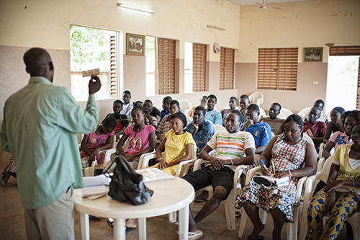
4. Documenting experiences from implementation
Only a small number of countries have scaled up CSE.
Where CSE is scaled-up:
It often reaches students late.
Fails to reach marginalized adolescents.
Important content is often removed.
Its messages do not relate to the realities of many adolescents’ lives.
Teachers – in many places - find it very difficult to teach sensitive topics.
Faces resistance & backlash.
N Haberland, D Rogow. Sexuality Education: Emerging Trends in Evidence and Practice. Journal of Adolescent Health, 2015.

Slide 7
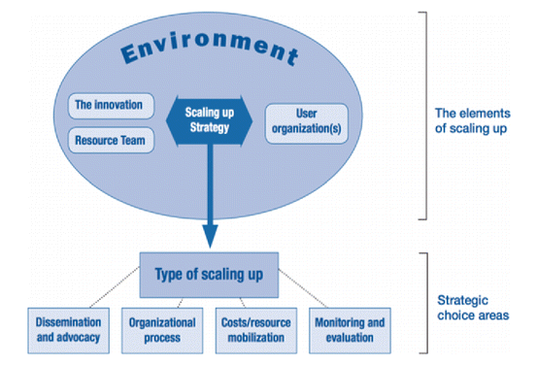
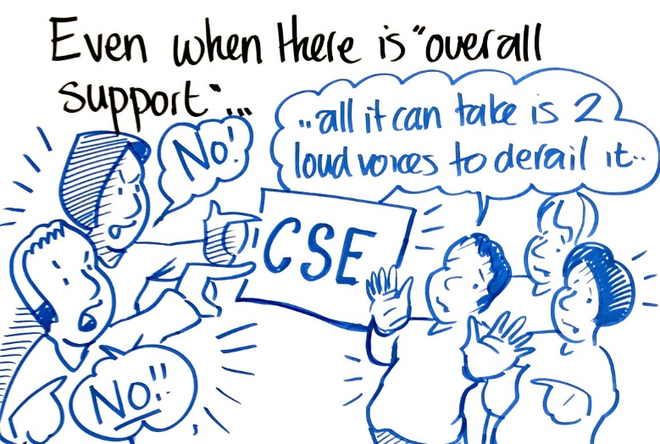
Documenting experiences from implementation
Scaling up & sustaining programmes
India, Nigeria, Pakistan, Senegal
Building community support & addressing backlash
India, Mexico, Nigeria, Pakistan, Texas USA

Slide 8
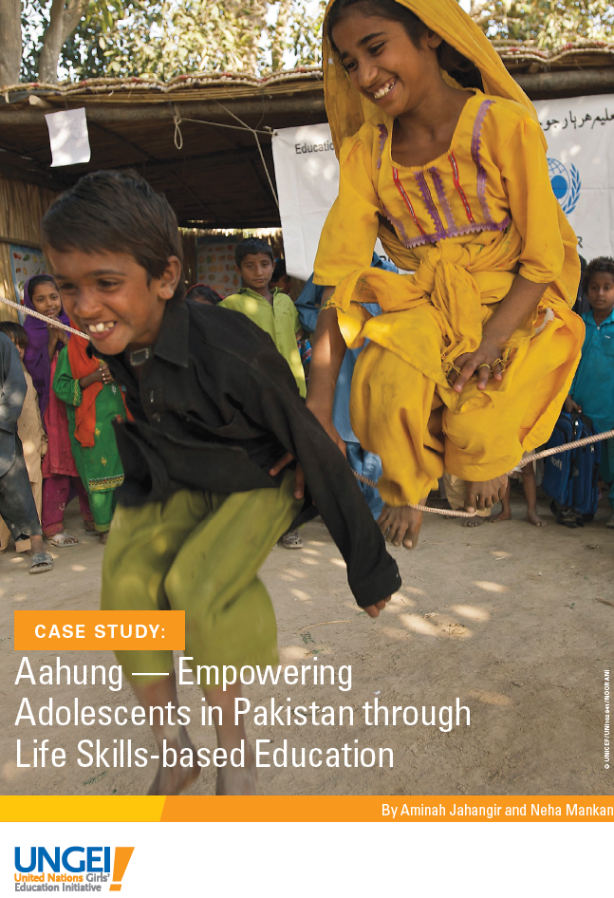
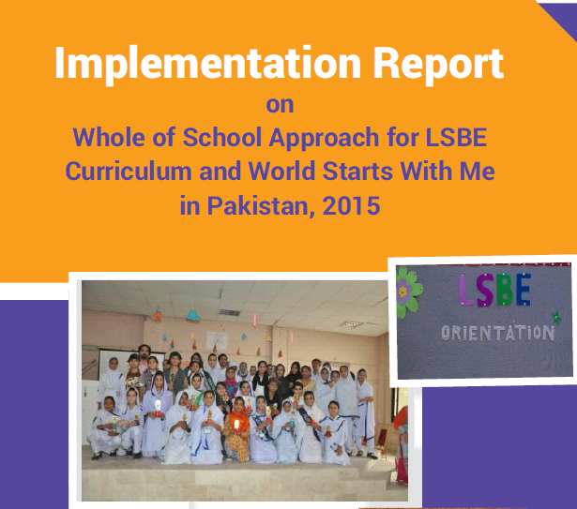
The case of Pakistan
Context:
National policy on sexuality education in place
Little government-led implementation
Rutgers Pakistan & Aahung built community support
By strategically choosing issues to address
By framing their work with care
By having sensitive content vetted
By actively reaching out to all to explain what they were doing
They dealt with backlash
(from an alliance of media/politicians/religious leaders)
By using supportive media persons as intermediaries
By arranging for journalists to visit the schools & see for themselves what was going on
By organizing information sharing/discussion sessions

Slide 9
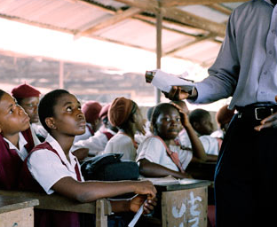

The case of Nigeria
Building support for national policy formulation
A group of NGOs led by Action Health Incorporated demonstrated the need, feasibility & effectiveness of sexuality education in projects
They formed a national coalition to advocate for a national policy & strategy
The coalition worked with internal & external change agents to contribute to a policy & national scale up plan – an eight-year journey
Building support as nation-wide scale up occurred
State level advisory & advocacy committees involving teachers’ unions & parents groups
Proactive, energetic & on-going consultations continued with supporters & opponents

Slide 10


The case of Texas, USA
Context:
State government does not fund sexuality education
No obligation on schools to conduct sexuality education
Building community support
By advocating with school board members about the link between dropout prevention & teenage pregnancy prevention
By working with school board members to appoint supporters of sexuality education in school health advisory councils
By training & supporting advisory council members
Dealing with resistance/backlash
(from groups of parents often supported from the outside)
By lobbying through school advisory council members, relying on trusted relationships that have been built in advance

Slide 11
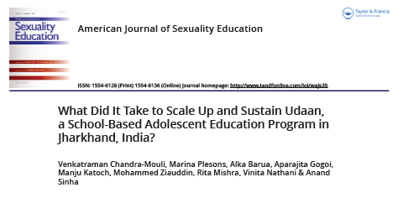
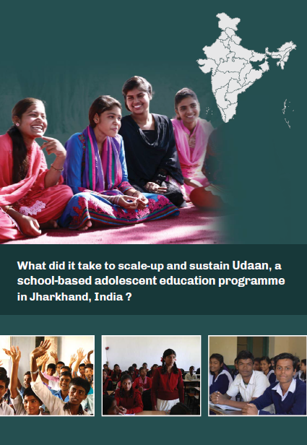
The case of India

Slide 12
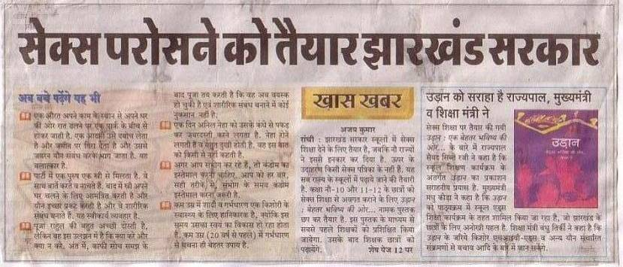
Prabhat Khabar (July 28, 2007)

Slide 13
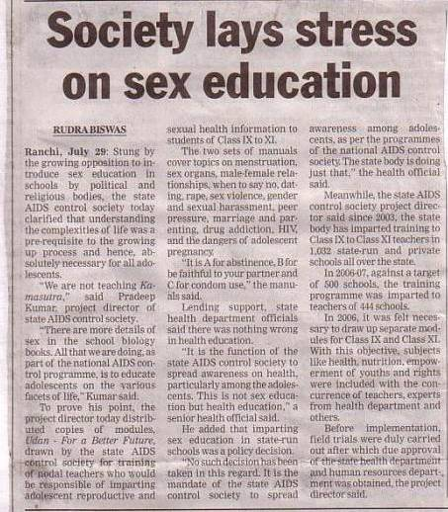
The Telegraph
July 30, 2007
Government of Jharkhand’s Dept of Education and JSACS - clarification and reply against backlash

Slide 14
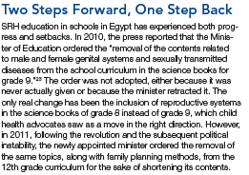

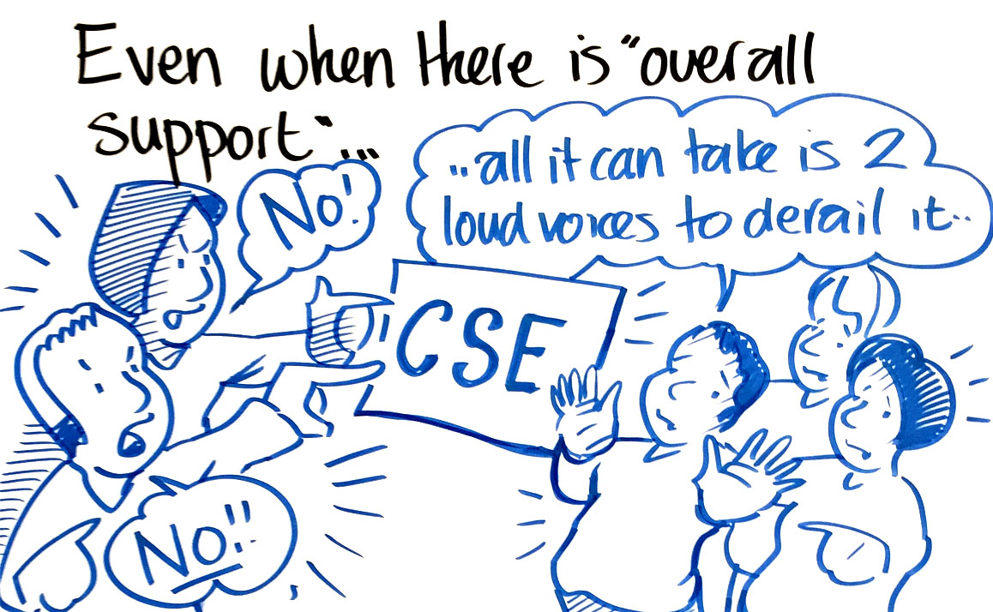
The case of Egypt

Slide 15
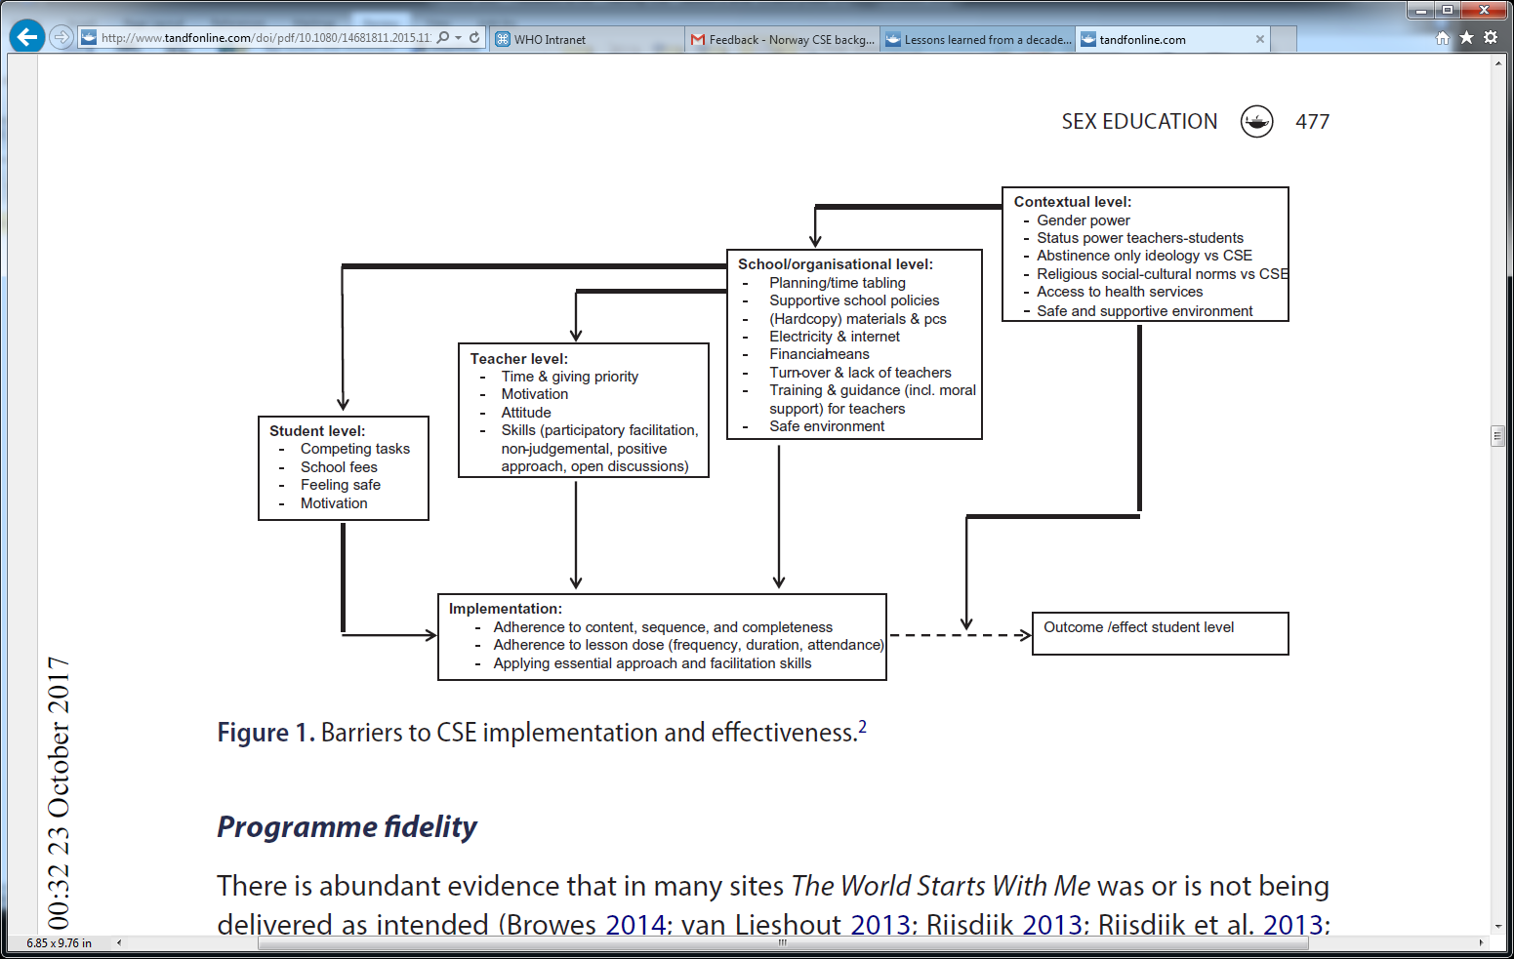
5. Supporting implementation research to address challenges in implementation
With UNFPA on designing & delivering out-of-school CSE
Ethiopia, Colombia, Malawi, Iran, Ghana
With Rutgers & the GEAS on building capacity & motivation of teachers
Indonesia
With Swiss Tropical & Public Health Institute on collaborative learning for teachers
Democratic Republic of Congo
I Vanwesenbeeck et al. Lessons learned from a decade implementing CSE in resource poor settings: The world starts with me. Sex Education, 2015.

Slide 16
Developing an effective approach to back lash at the global, regional, national & local levels

Slide 17

