Slide 1
Relationships, Sexual Health and Parenthood Education
- Scotland
‘6 Nations’ RSE Symposium
3rd October 2019
Suzanne Hargreaves – Education Scotland
Elaine McCormack – NHS Greater Glasgow and Clyde
Felicity Sung – Scottish Government
For Scotland's learners, with Scotland's educators

Slide 2
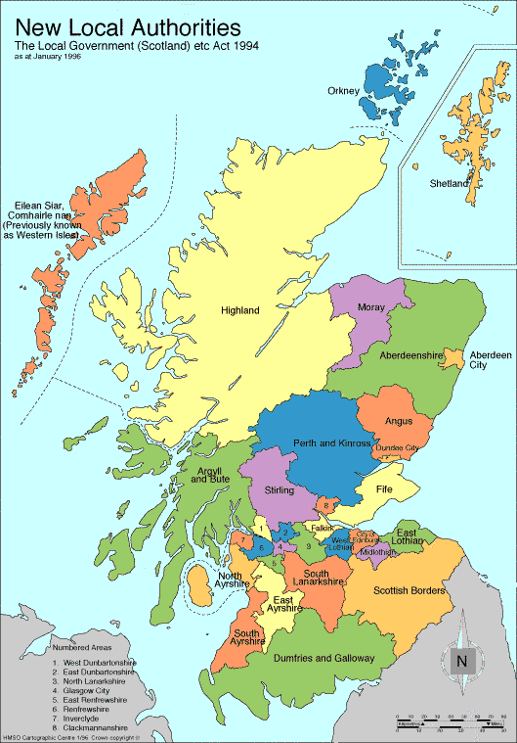
Scotland
Population: Around 5.2 million
Schools: 2,524
Pupils: 684,415
Teachers: 50,970
32 Local Authorities
Faculties of Education
Agencies
14 National Health Service Boards (NHS) Boards
For Scotland's learners, with Scotland's educators

Slide 3
What is RSHP?
Relationships, Sexual Health and Parenthood
Children and young people learn about healthy relationships, then sexual health and then parenthood.
Part of Health and Wellbeing within Scotland’s Curriculum for Excellence
Experiences and Outcomes https://education.gov.scot/Documents/health-and-wellbeing-eo.pdf
Benchmarks https://education.gov.scot/improvement/learning-resources/Curriculum%20for%20Excellence%20Benchmarks
For Scotland's learners, with Scotland's educators

Slide 4
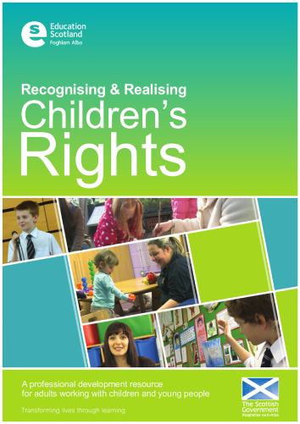

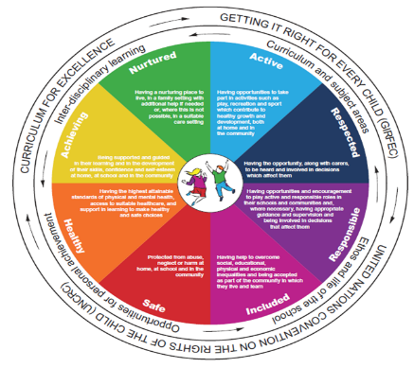

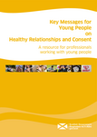
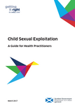
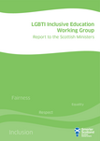
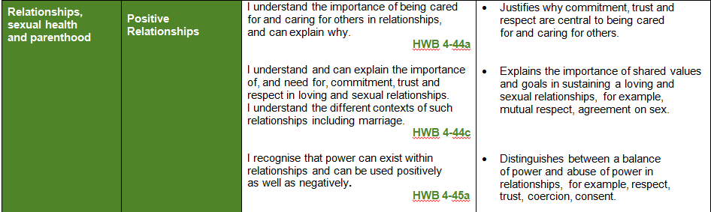

Current state of play in Scotland
For Scotland's learners, with Scotland's educators

Slide 5
Key changes and challenges in the past 10 years
Changes
Greater focus on health and wellbeing, of which RSHP is a crucial part.
Increased awareness of child sexual abuse and exploitation emphasising need to work with children and young people to understand what constitutes a ‘healthy relationship’.
Understanding of the changing needs of children and young people, particularly with technological advances (children and young people increasingly conducting friendships and relationships online)
Many young people expressing their need to know more about consent
All leading to increased acknowledgment of the need for high quality, consistent RSHP
Challenges
Delivery in different settings.
Confidence of teaching staff.
Consistency in delivery.
Lack of comprehensive and up to date teaching materials.
Aspects of popular culture, including pornography, promote unrealistic body image standards and sexual expectations as well as perpetuating gender stereotypes
Impact of pornography.
For Scotland's learners, with Scotland's educators

Slide 6
Links between RSE and Health Services
The NHS is a critical partner in the successful provision of RSHP education in Scotland.
NHS closely involved in development of policy as well as an integral partner in the delivery of RSHP
Highlighting and sharing good practice across Scotland.
Offer training and development to teaching staff on RSHP education
Support teachers and schools in the delivery of relevant, engaging age and stage appropriate learning.
Local health services are signposted to, some schools will offer ‘drop in’ services for pupils, which include sexual health support.
For Scotland's learners, with Scotland's educators

Slide 7
Progress in the next 5 years – RSHP Online Teaching Resource
New Online RSHP Teaching Resource – launched on 25 September
Developed as a result of an identified need for RSHP to be fully modernised in co-production with young people – a recommendation from Scottish Parliament’s Education and Skills Committee in their report ‘Let’s talk about Personal and Social Education ‘ (May 2017).
The development involved a network of over 1500 professionals and partners over the last two years.
Piloted in 38 schools across Scotland.
Teachers, practitioners and parents now have access to relevant factual information as well as learning activities that are age and stage appropriate.
https://rshp.scot/
For Scotland's learners, with Scotland's educators

Slide 8
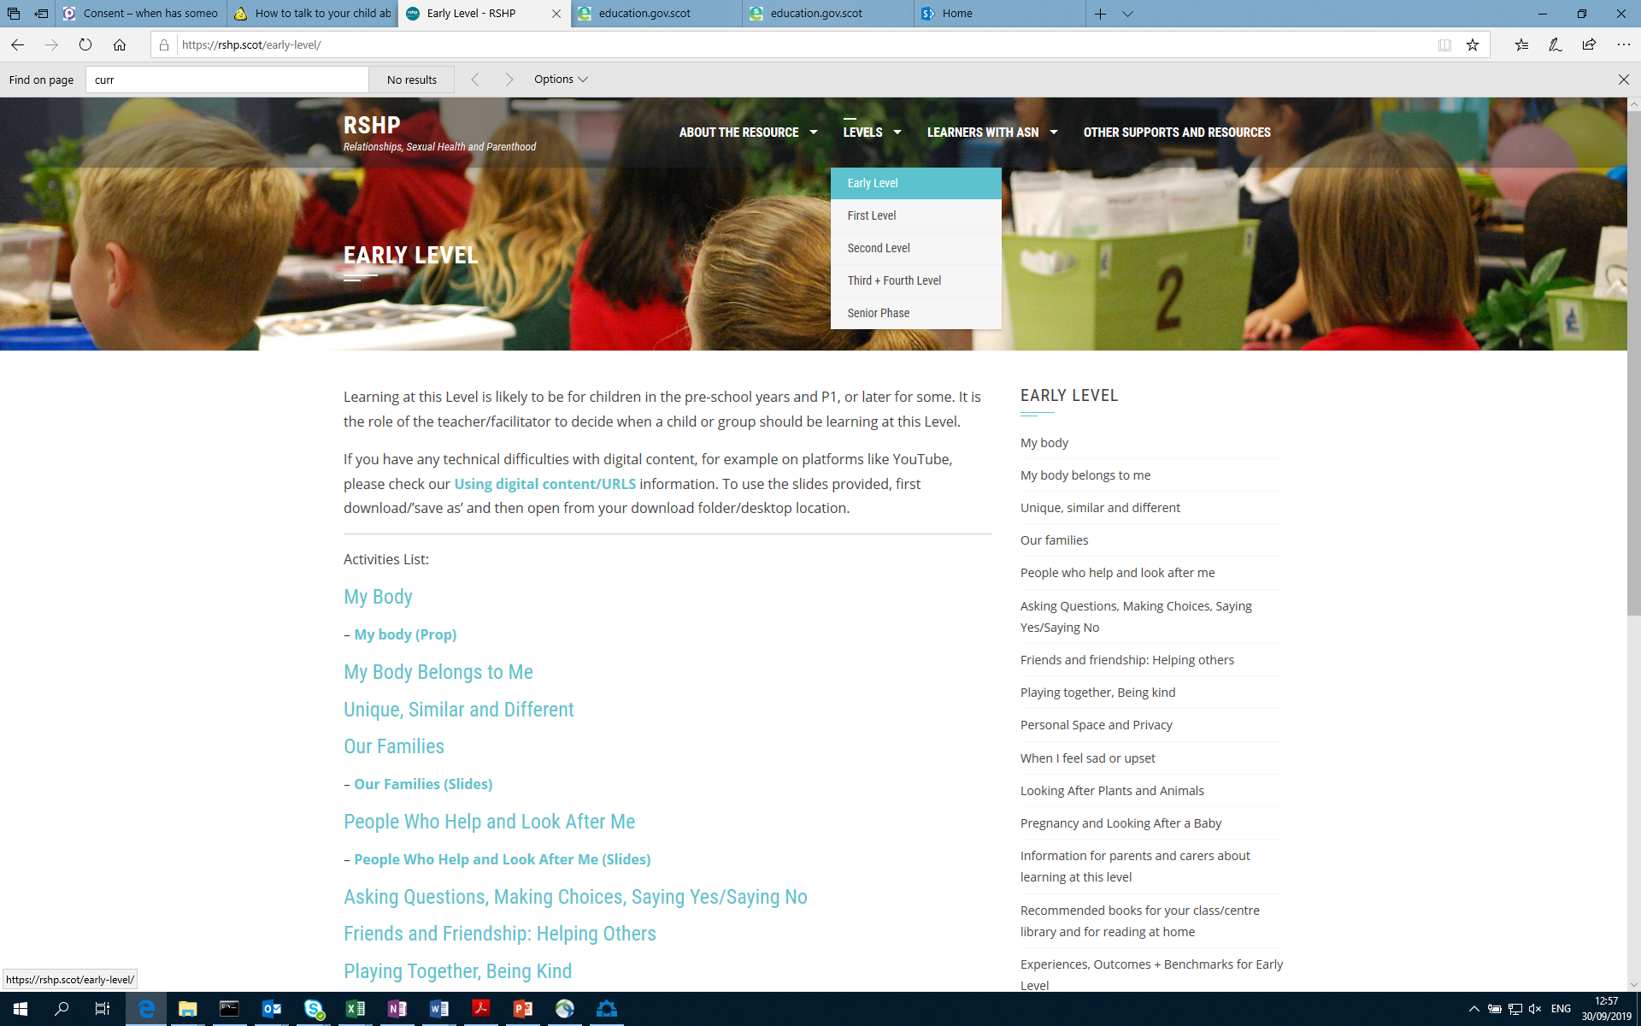
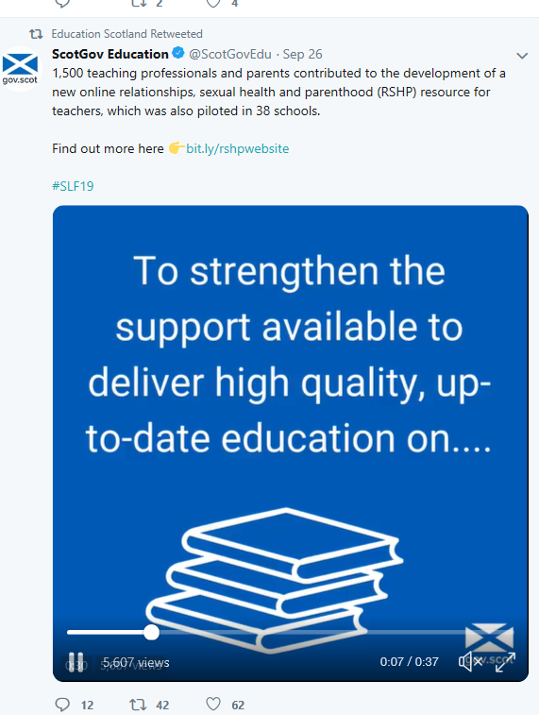
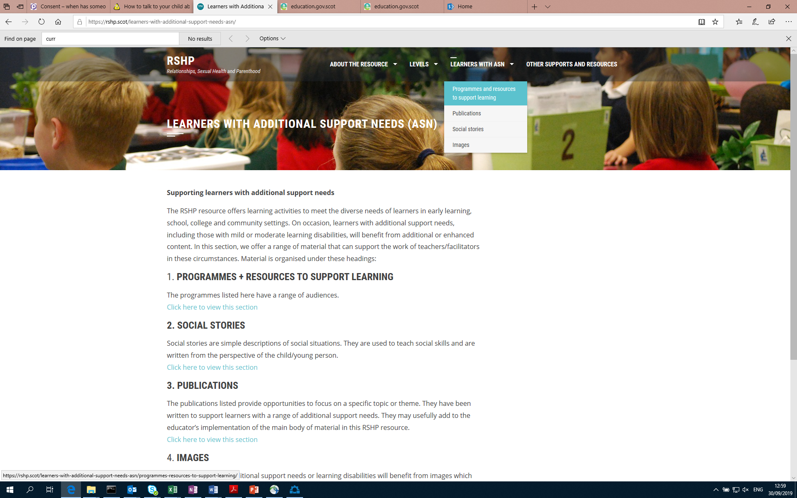
For Scotland's learners, with Scotland's educators

Slide 9
Progress in the next 5 years – cont’d
Alongside the RSHP online resource, complementary career long professional learning to support and raise teacher confidence.
Revised statutory teaching guidance, to be consulted on over the Winter.
Monitoring effectiveness of health and wellbeing learning
Ongoing monitoring and updating of the Online Resource
.
For Scotland's learners, with Scotland's educators

Slide 10
Any Questions?
For Scotland's learners, with Scotland's educators

